Slide 1
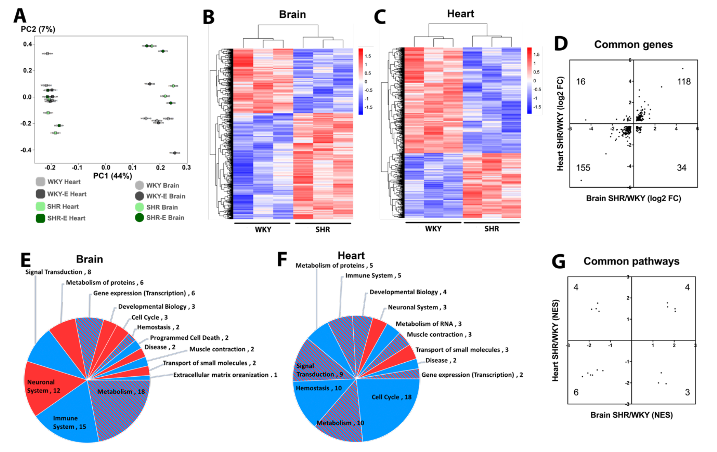
Figure 2. (A) Principal component analysis of vasculomes from 4 groups. Heatmap of hypertension-induced DEGs in SHR (B) brain and (C) heart. (D) Distribution of fold-change directions for common DEGs in brain and heart of SHR. Pie chart of Reactome pathways induced by hypertension in (E) SHR brain and (F) SHR heart; red for upregulation, blue for downregulation, and shaded for mixed directions of change. (G) Distribution of change directions for common Reactome pathways in brain and heart of SHR.
Lan et al., Conditioning Medicine 2019; 2(1):50-61.

