Slide 1
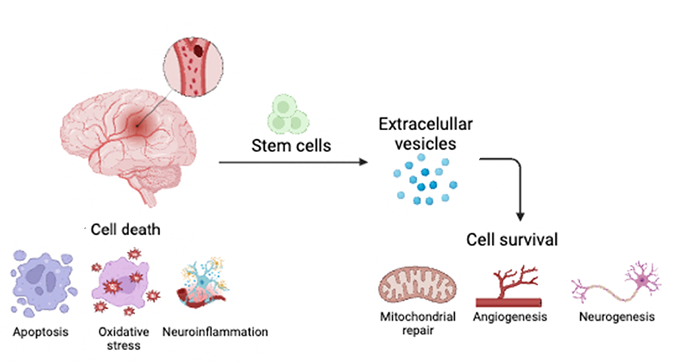
Figure 1.
Alvarez et al., Conditioning Medicine 2023; 6(5): 155-159.

