Slide 1
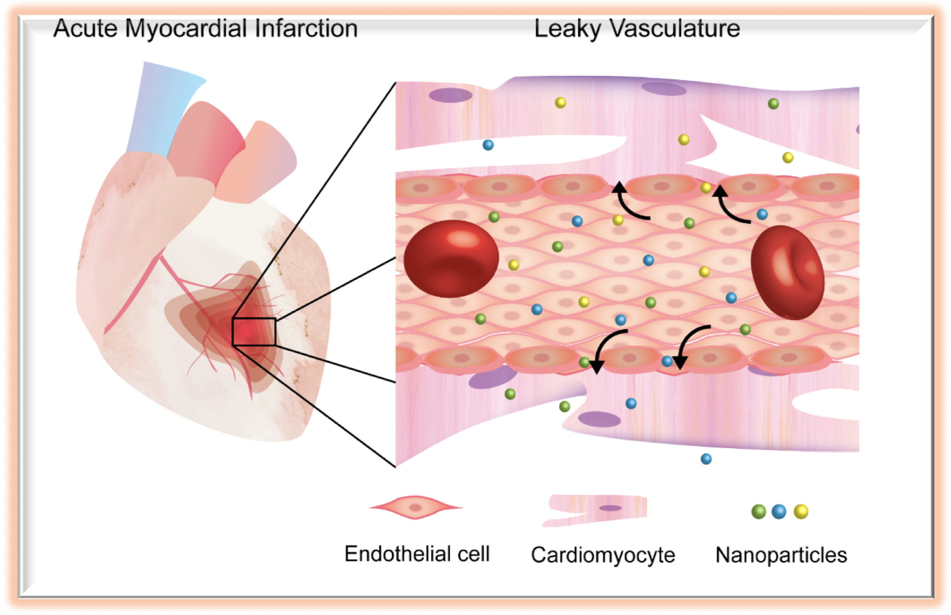
Figure 1. Schematic illustration of nanoparticle delivery in acute myocardial infarction.
Abraham Mendez-Fernandez et al, Conditioning Medicine 2020; 3(1):18-30.

