Slide 1
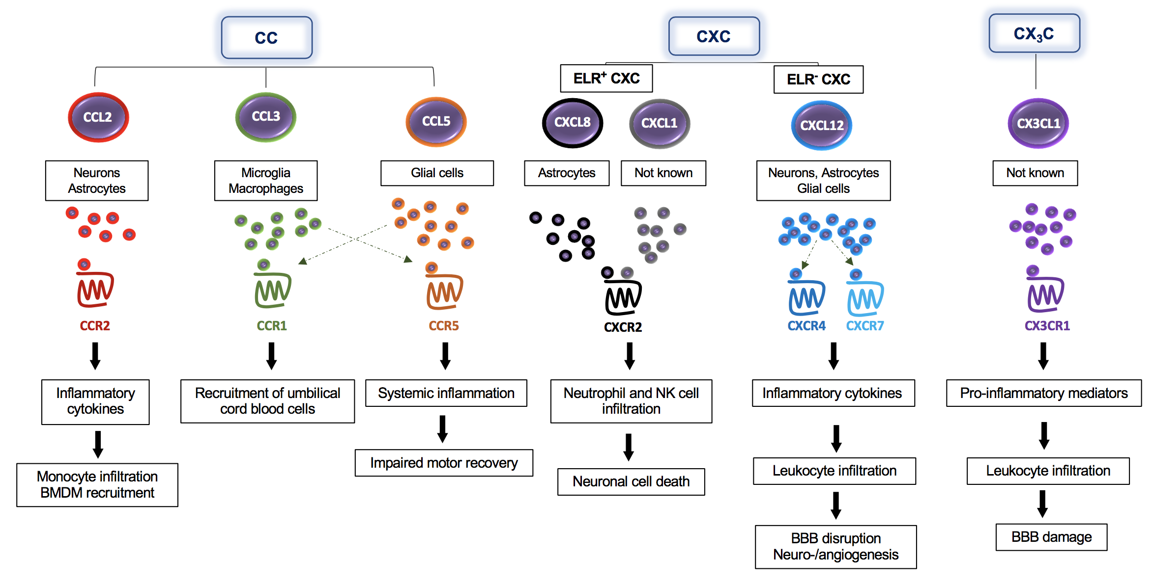
Figure 1. The multifaceted impact of classical chemokines on the pathogenesis of ischemic stroke – classes, cells, receptors, and downstream effects.
Wang et al., Conditioning Medicine 2021; 4(1):39-57.

