Slide 1
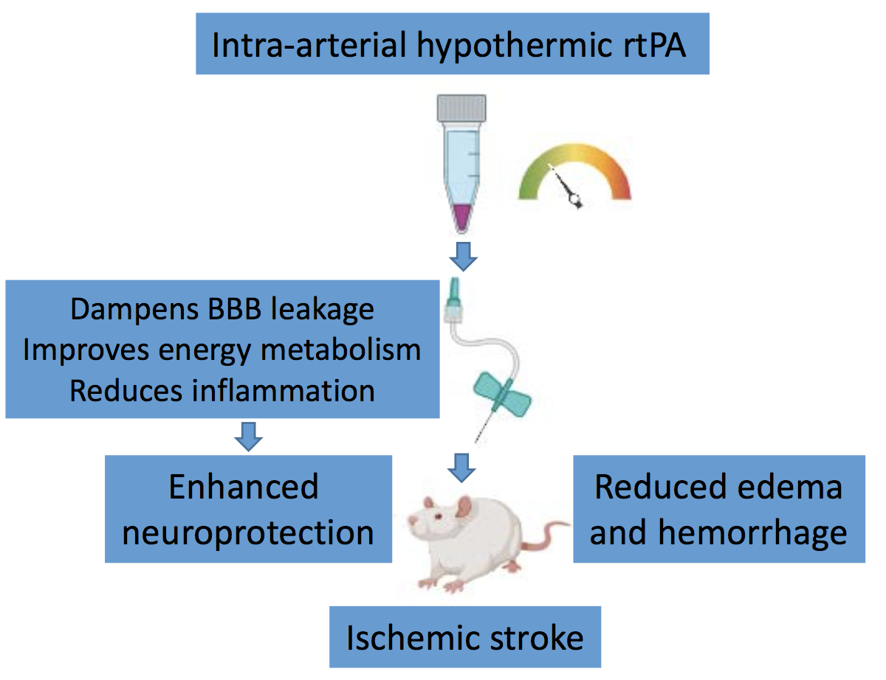
Figure 1.
Borlongan et al., Conditioning Medicine 2023; 6(5): 160-164.

