Slide 1
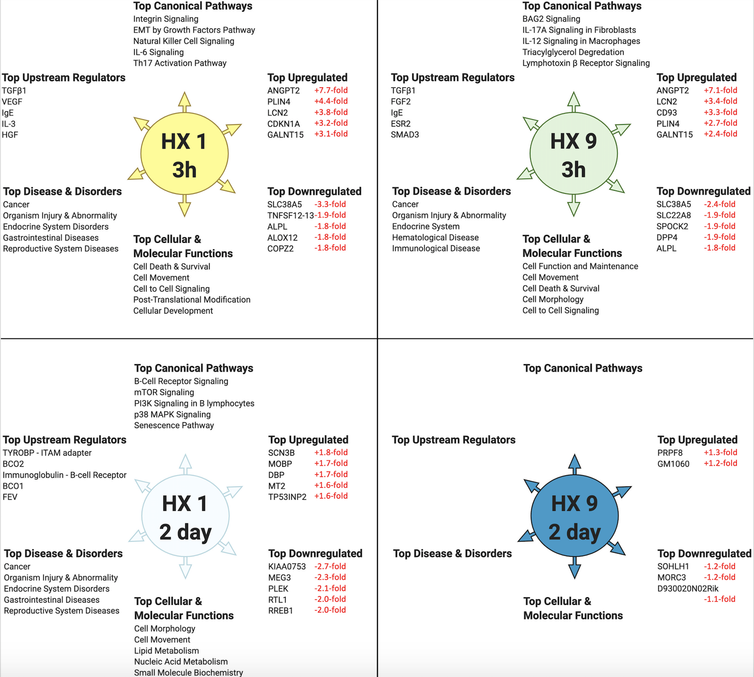
Figure 2. Top-ranked bioinformatic findings based on the differentially expressed cerebral microvessel genes for each experimental preconditioning protocol and time point, relative to untreated naïve mice.
Harman et al., Conditioning Medicine 2021; 4(1):58-68.

