Slide 1
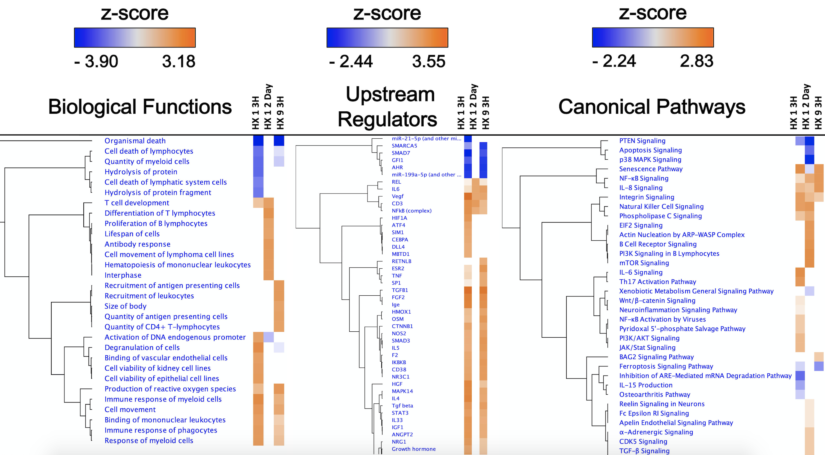
Figure 3. Top-ranked Biological Functions, Upstream Regulators, and Canonical Pathways resulting from IPA’s ‘Comparison Analyses’ of the experimental groups.
Harman et al., Conditioning Medicine 2021; 4(1):58-68.

