Slide 1
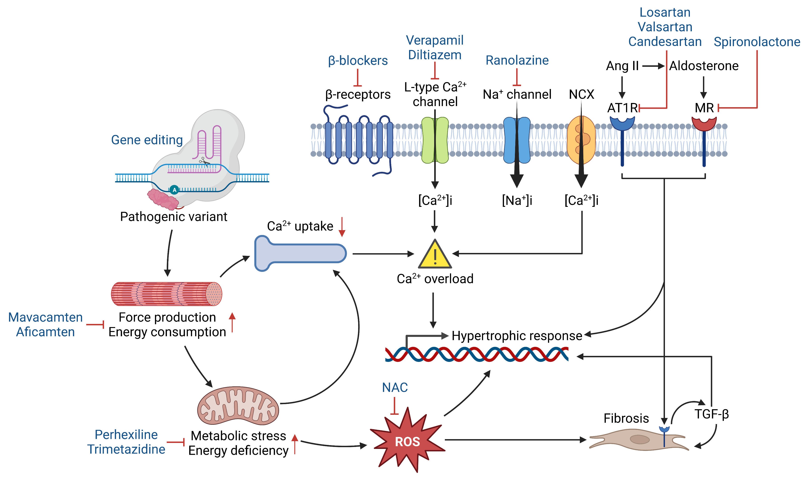
Figure 1.
Ramachandra et al., Conditioning Medicine 2023; 6(1): 15-24.

