Slide 1
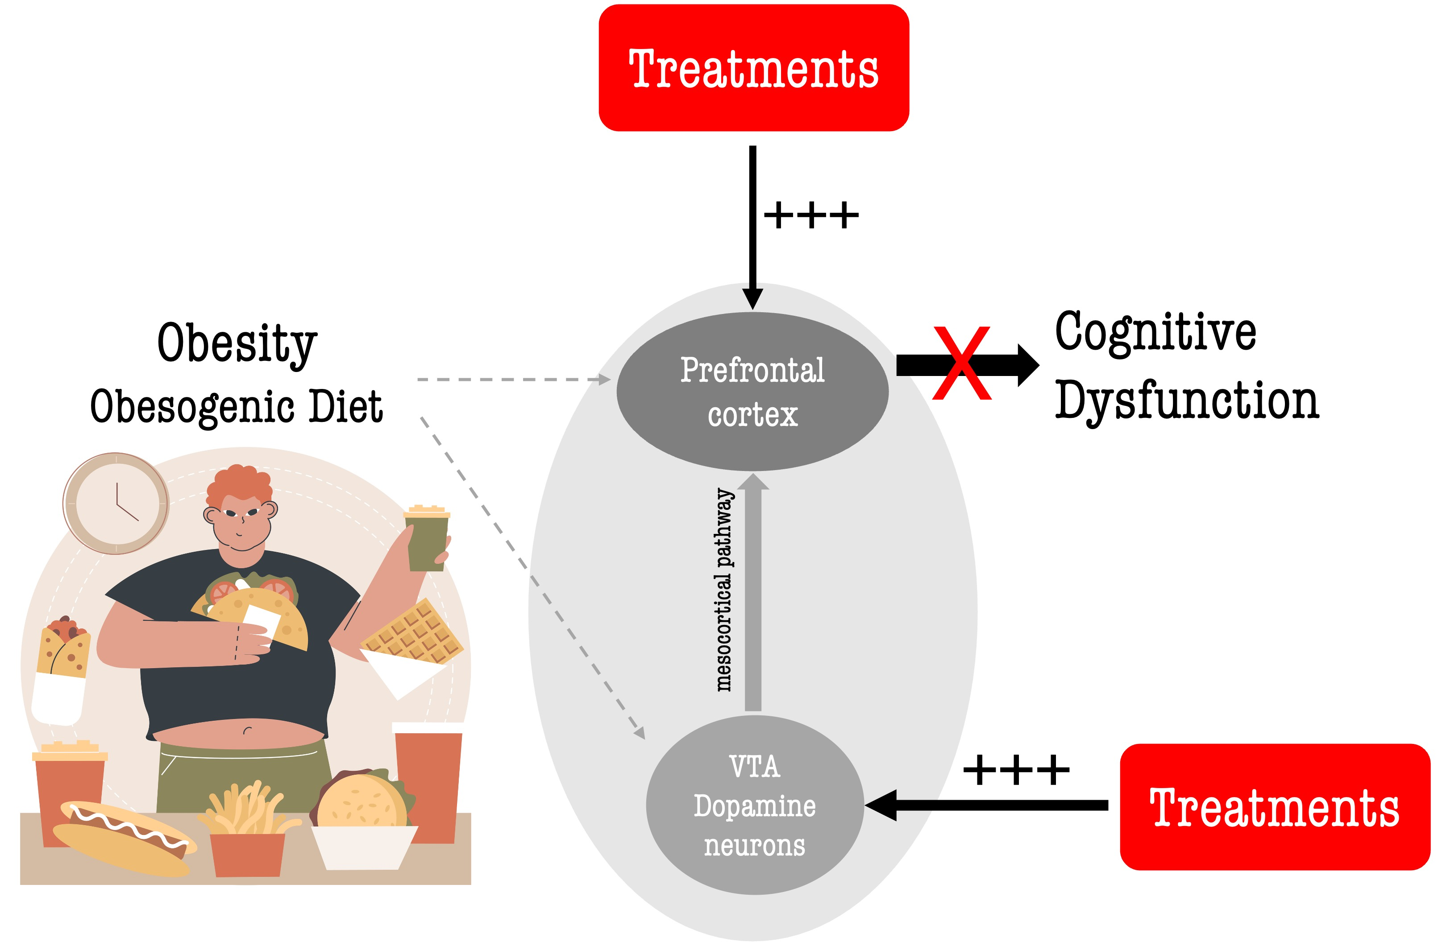
Figure 1.
Ike de la Peña et al., Conditioning Medicine 2023; 6(6): 170-176.

