Slide 1
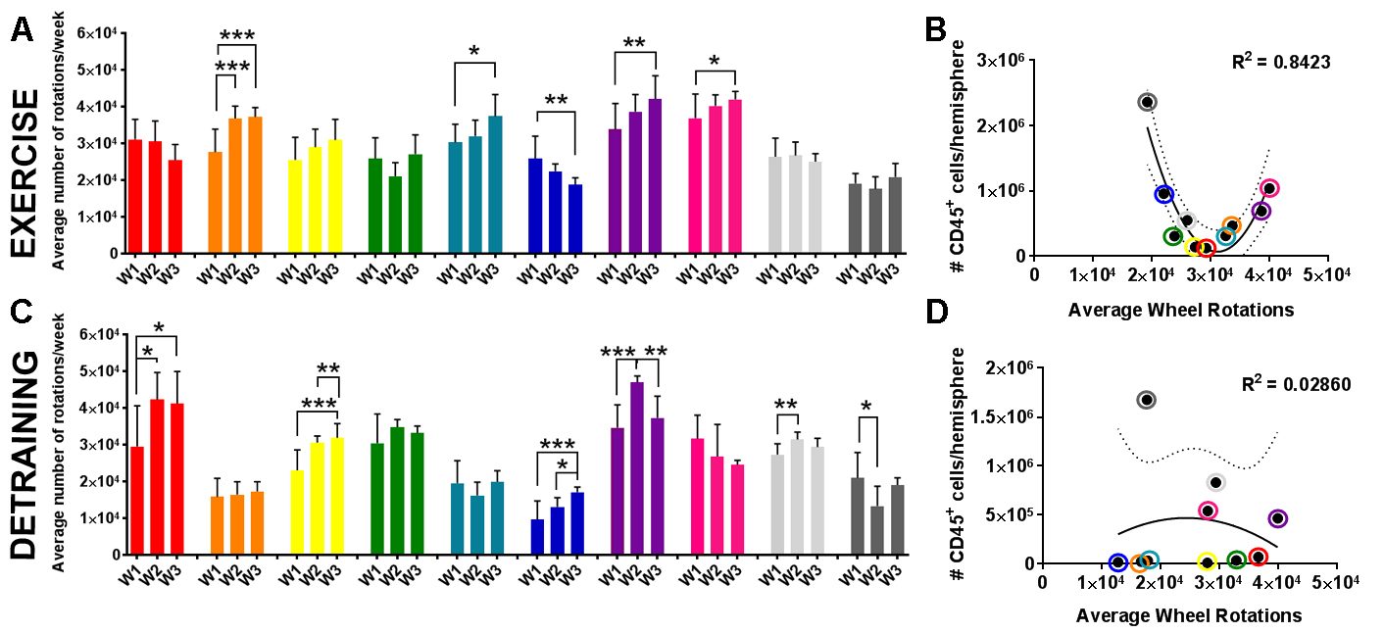
Figure 6. Detraining ablates the effect of exercise volume on leukocytes in the brain.
Poinsatte et al., Conditioning Medicine 2019; 2(2):50-60.

