Slide 1
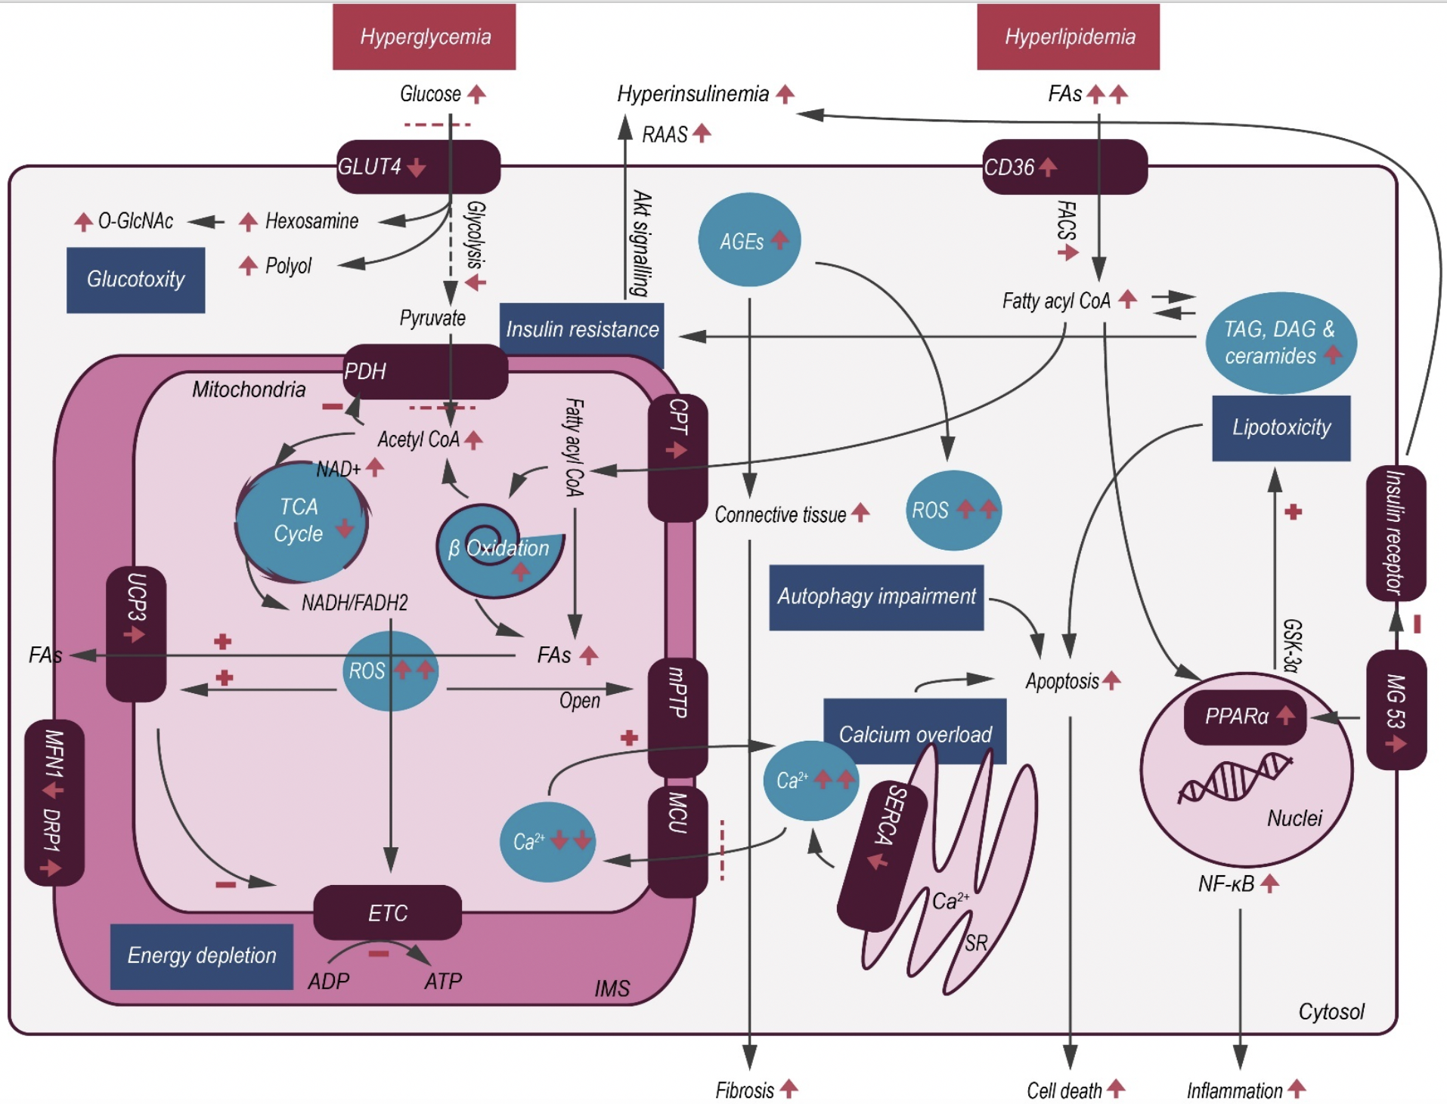
Figure 1. Schematic illustration of cardiac metabolic alterations in DC.
Shuo Cong et al, Conditioning Medicine 2020; 3(2):82-97.

