Slide 1
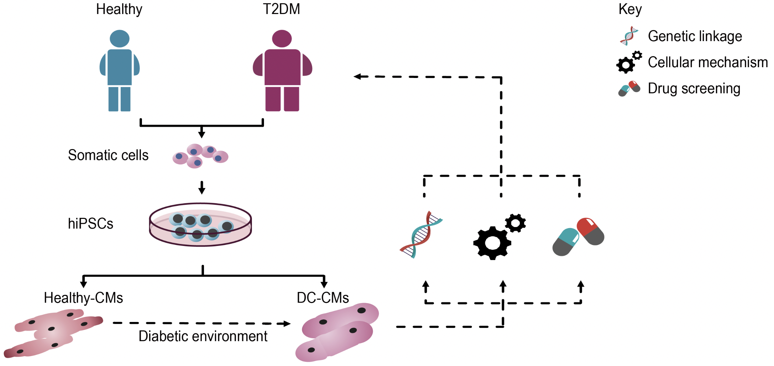
Figure 2. Schematic representation illustrating the use of hiPSCs to model DC and for identifying novel targets for patient-specific therapies.
Shuo Cong et al, Conditioning Medicine 2020; 3(2):82-97.

