Slide 1
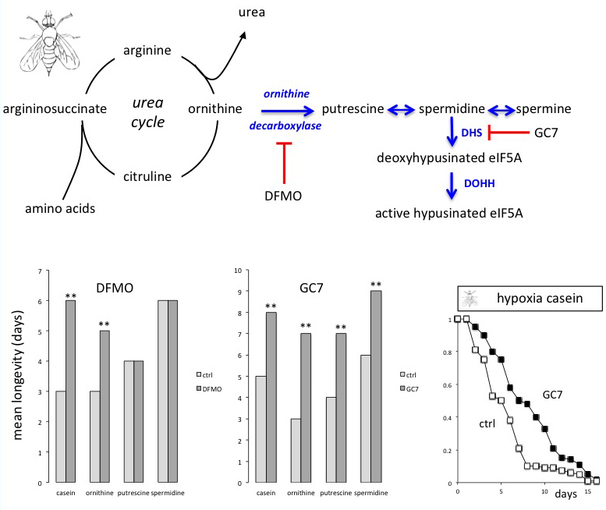
Figure 1. Schema of the urea cycle involved in the catabolism of amino acids leading to polyamines synthesis through sequential enzymatic catalysis.
Michel Tauc et al., Conditioning Medicine 2019; 2(2):69-74.

