Slide 1
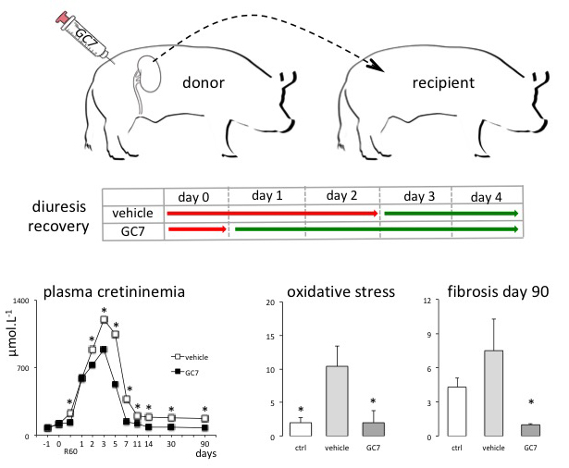
Figure 3. Schema of the preclinical use of GC7 in kidney transplantation. The donor pig was preconditioned with GC7 before kidney removal.
Michel Tauc et al., Conditioning Medicine 2019; 2(2):69-74.

