Slide 1
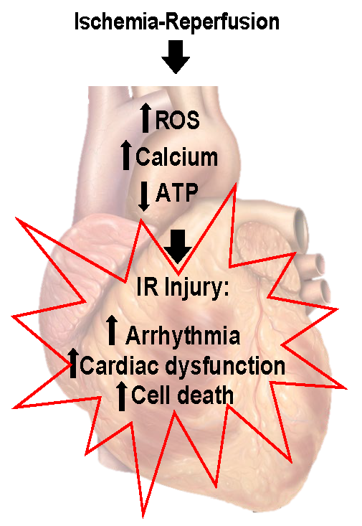
Figure 1. Ischemia reperfusion injury.
Lindsey E. Miller and John C. Quindry, Conditioning Medicine 2020; 3(2):59-70.

