Slide 1
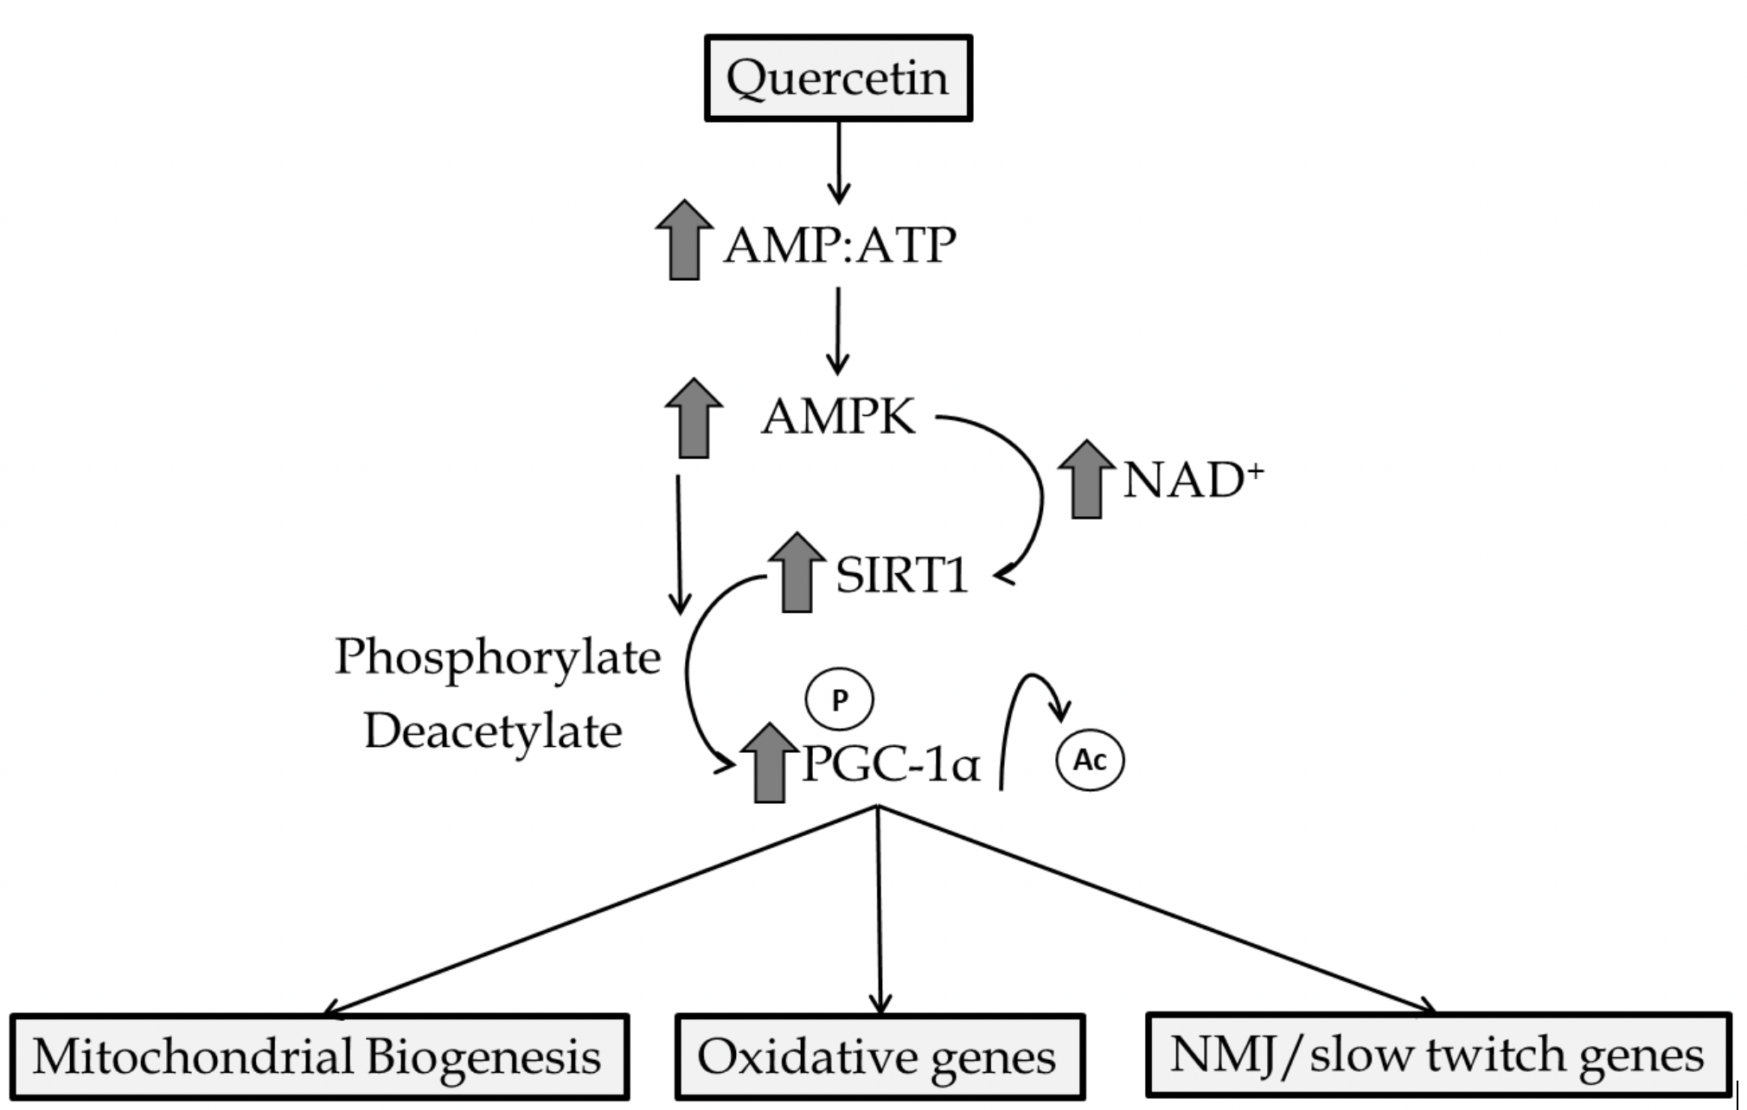
Figure 2. Primary quercetin mediated activation of AMPK/SIRT1/PGC-1α.
Christopher G. Ballmann et al., Conditioning Medicine 2020; 3(3):117-124.

