Slide 1
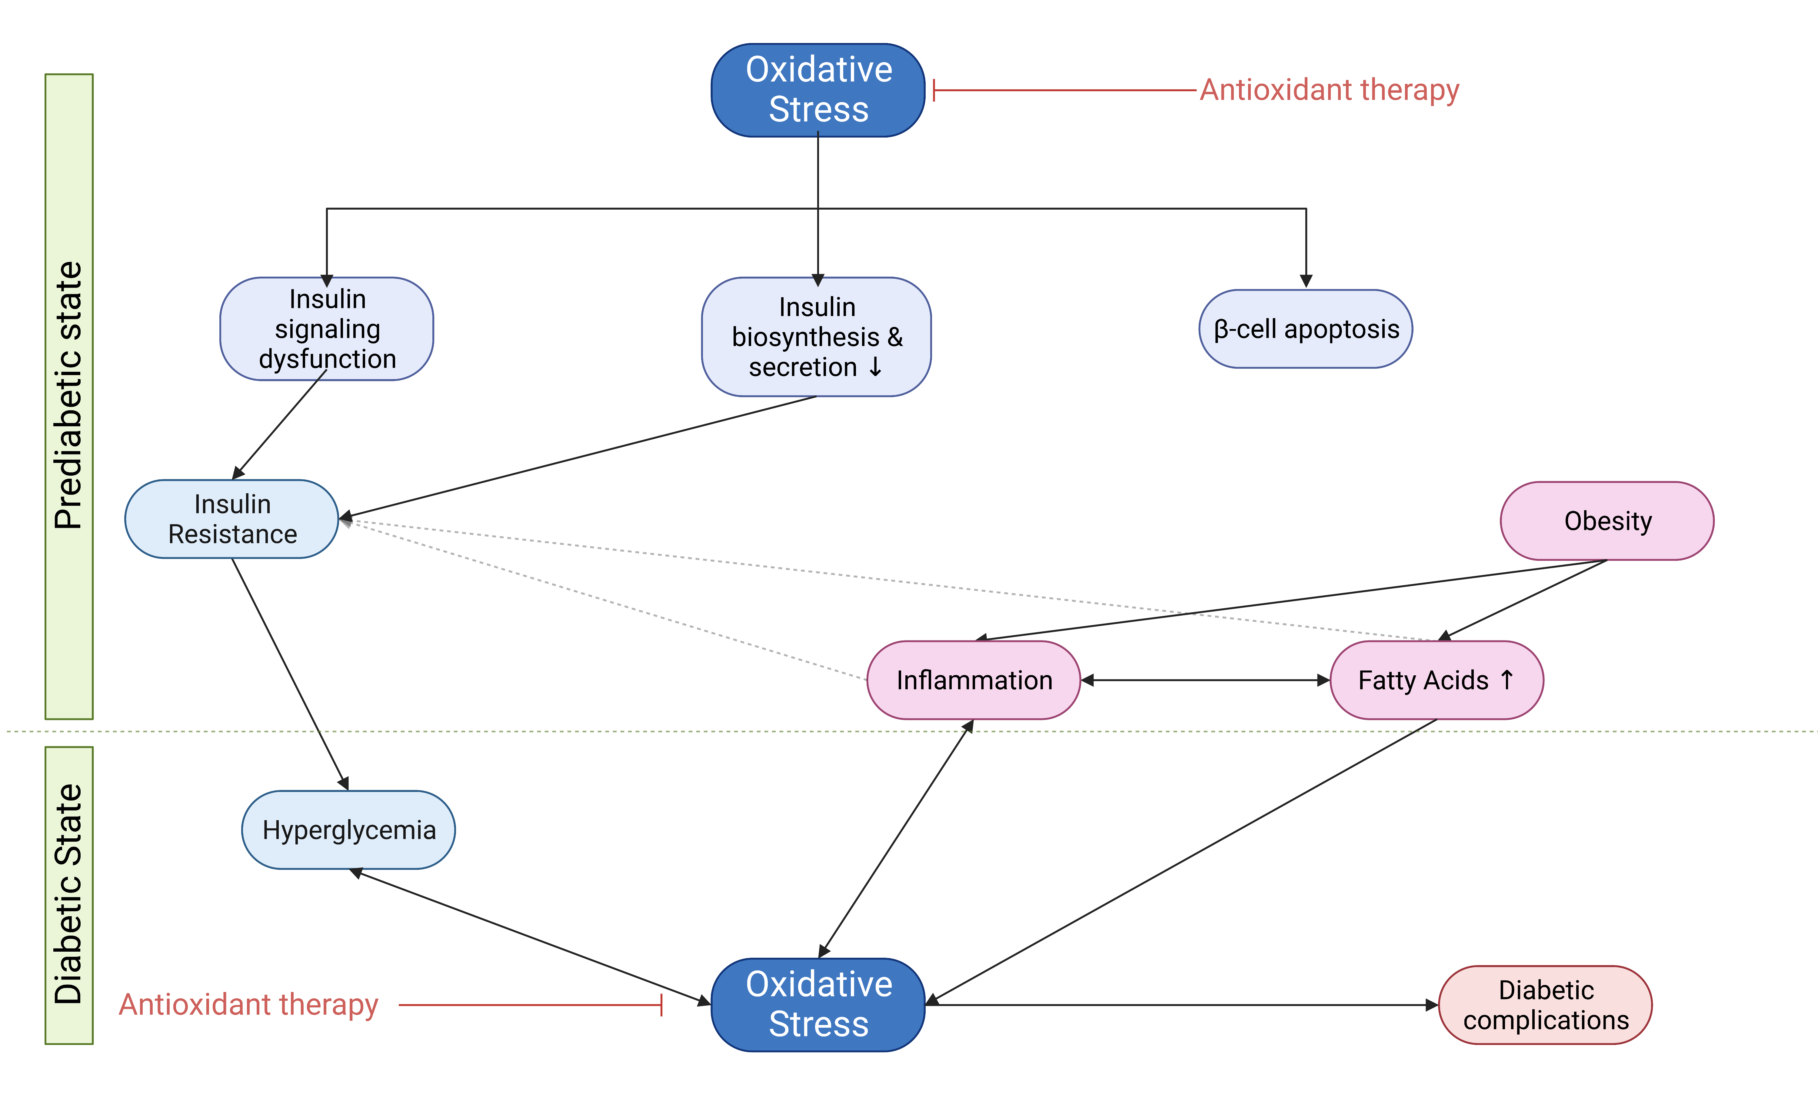
Figure 3.
Bertos et al., Conditioning Medicine 2023; 6(4): 98-119.

