Slide 1
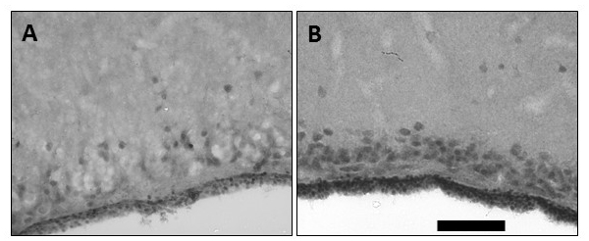
Figure 3. Imunohistochemical labeling of vascular endothelial growth factor (VEGF).
Milton et al., Conditioning Medicine 2019; 2(2):90-105.

