Slide 1
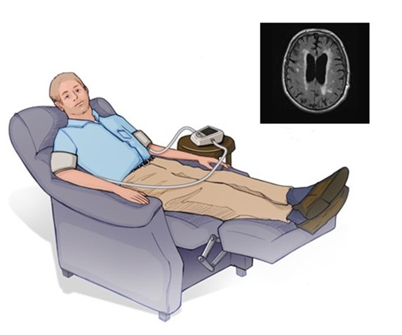
Figure 1.
Hess et al.; Conditioning Medicine 2024; 7(1): 6-10.

