Slide 1
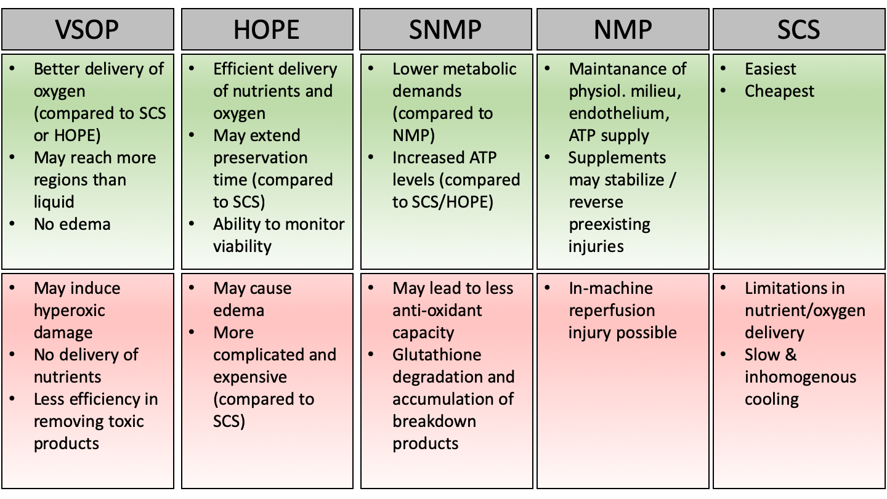
Figure 2. Advantages (green) and disadvantages (red) of different machine perfusion techniques.
Christoph Emontzpohl et al., Conditioning Medicine 2020; 3(3):135-143.

