Slide 1
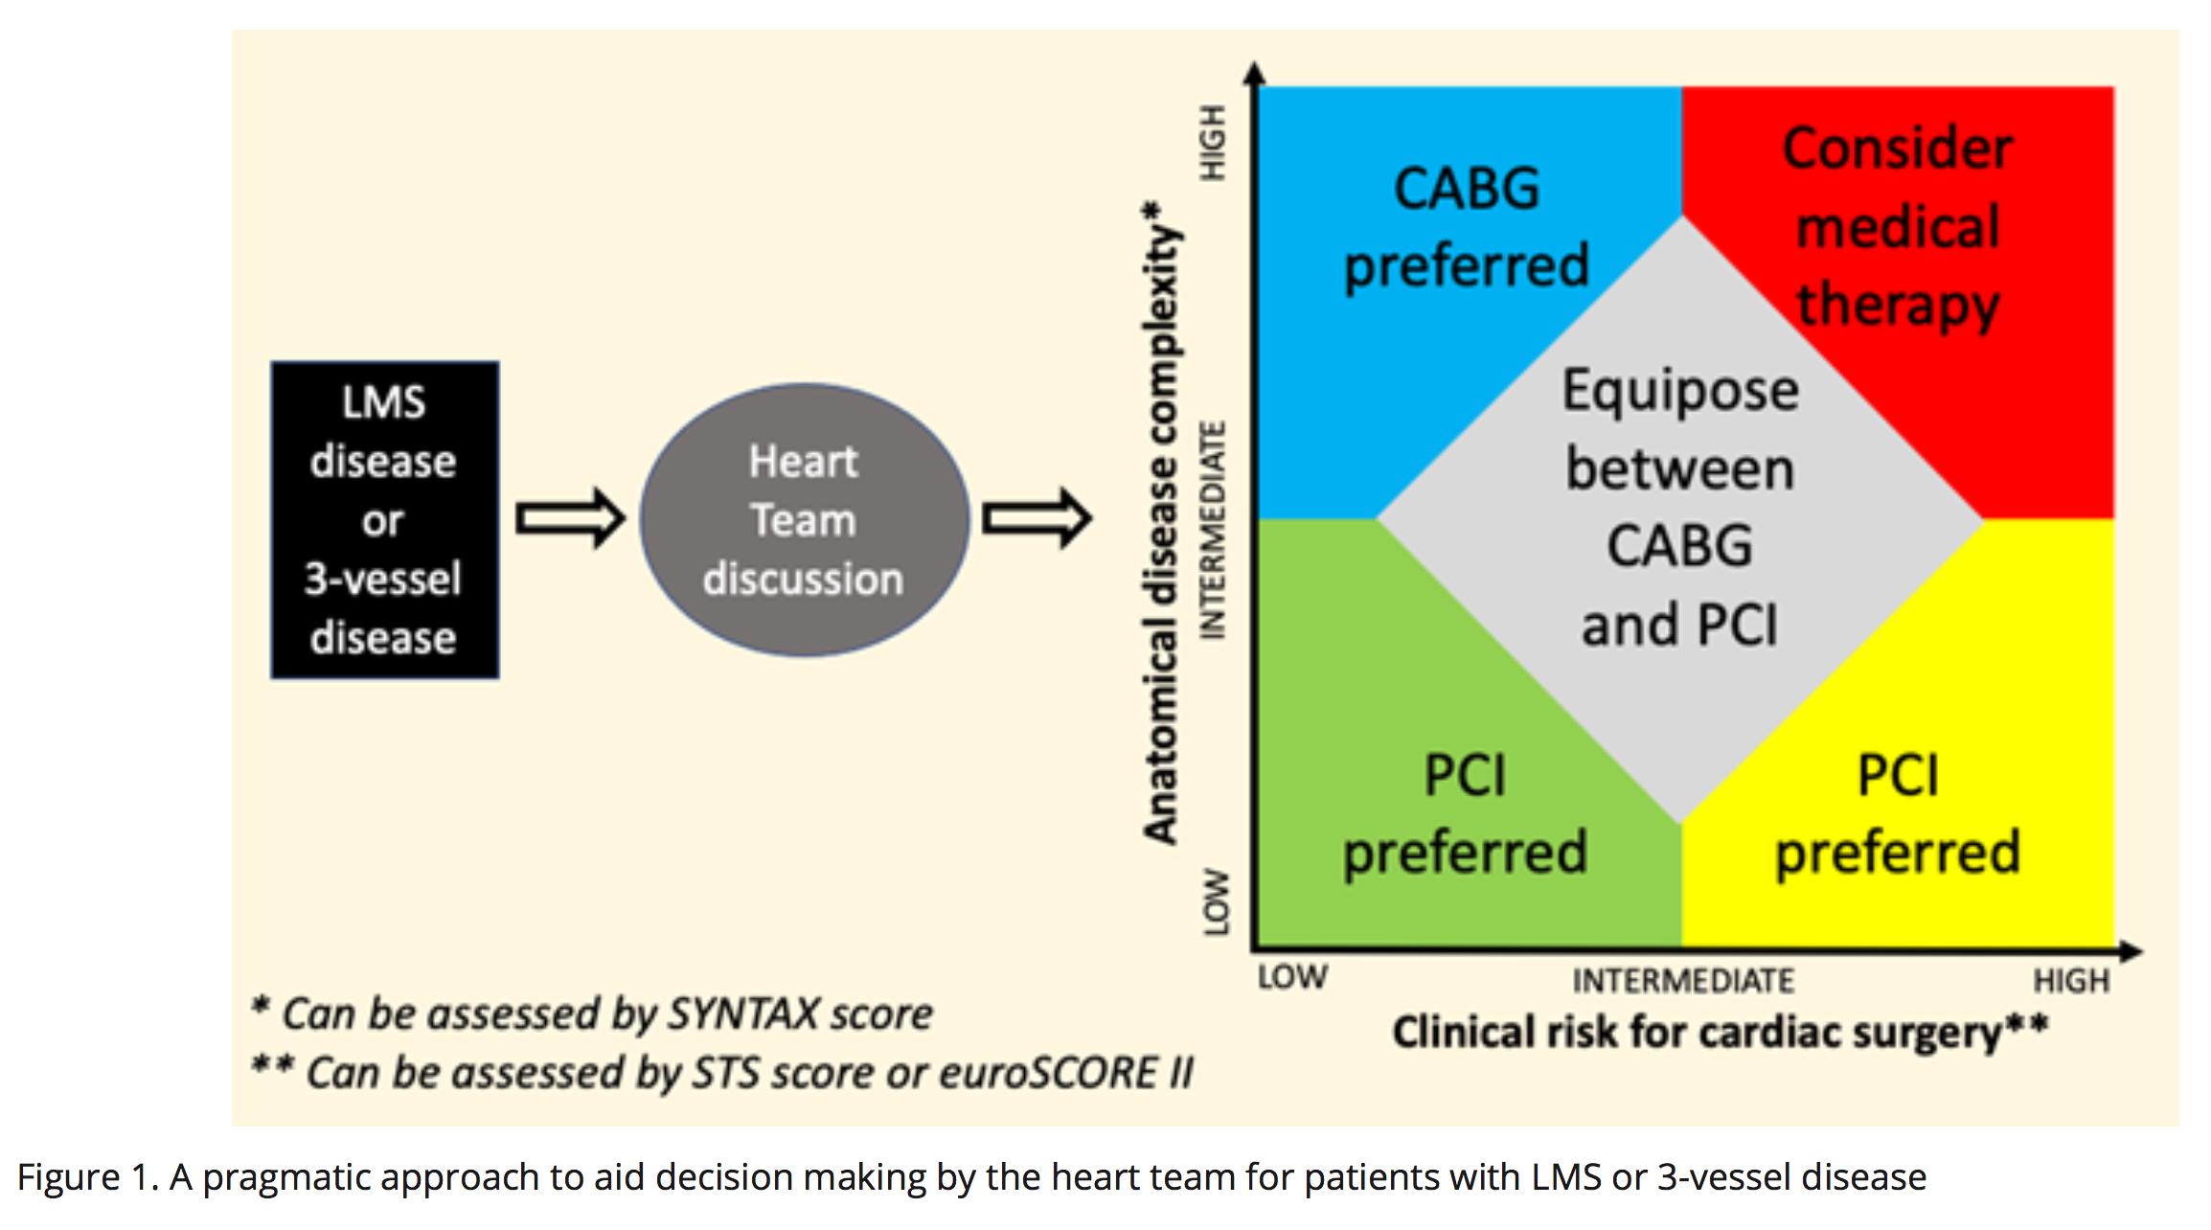
Figure 1.
Woodhead et al., Conditioning Medicine 2022; 5(3): 100-104.

