Slide 1
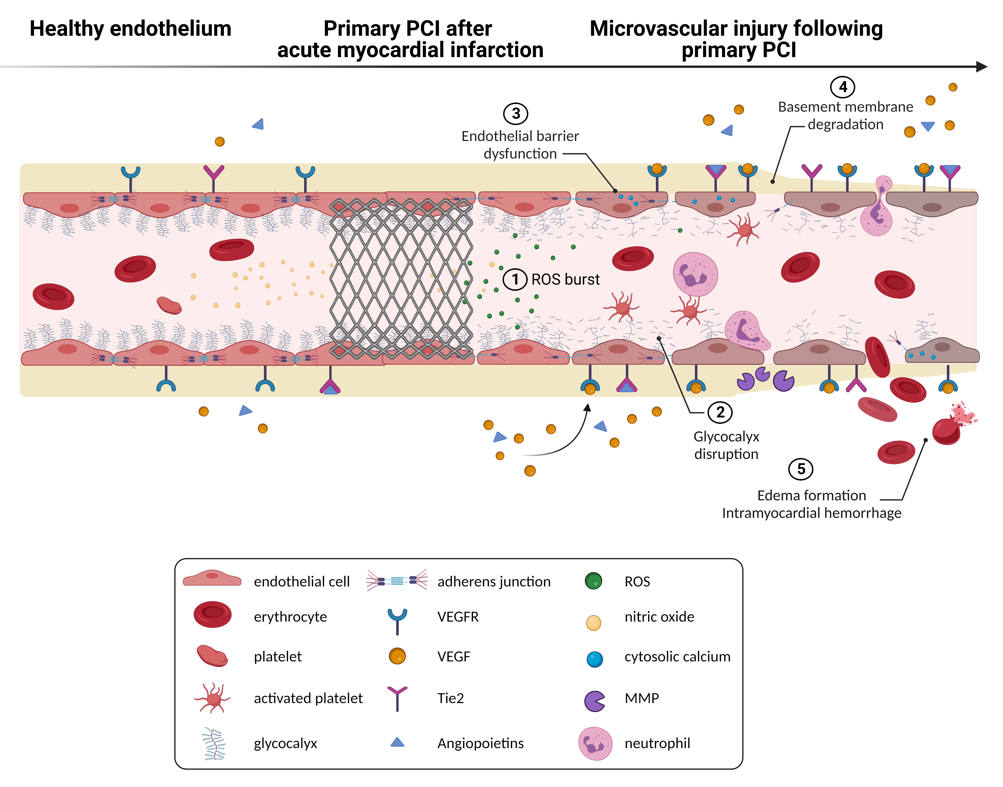
Figure 1.
Konijnenberg et al., Conditioning Medicine 2022; 5(4): 144-154.

