Slide 1
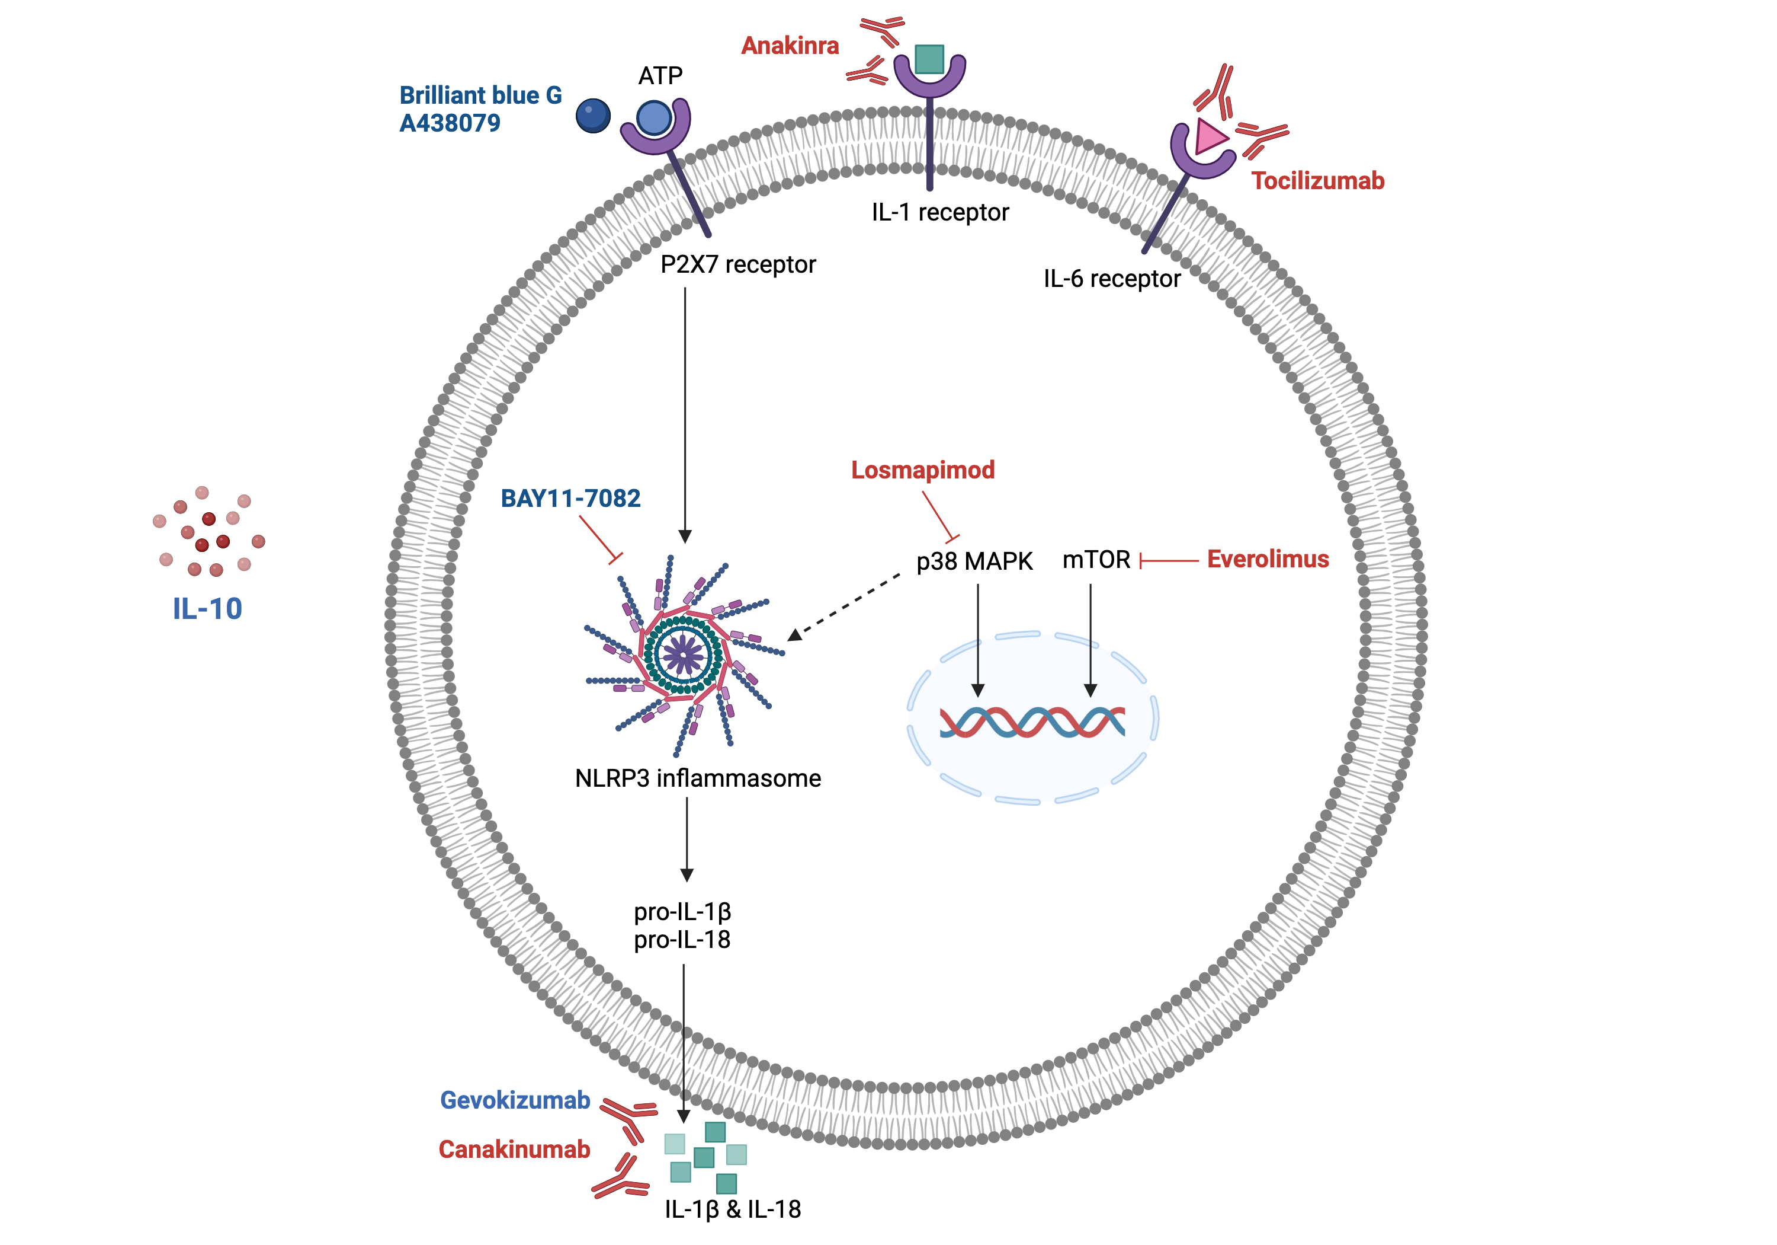
Figure 1.
Dam et al., Conditioning Medicine 2023; 6(4): 120-130.

