Slide 1
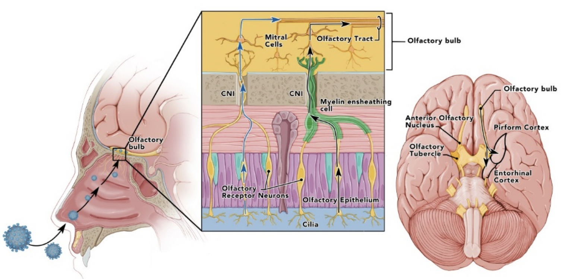
Figure 1. Olfactory pathways with depiction of SARS-CoV-1 or 2 infecting nasopharynx with infection, or invasion of olfactory epithelium and spread up from the olfactory nerve to olfactory bulb and later into olfactory pathways including the pirirform cortex.
Hess et al., Conditioning Medicine 2020; 3(5):241-245.

