Slide 1
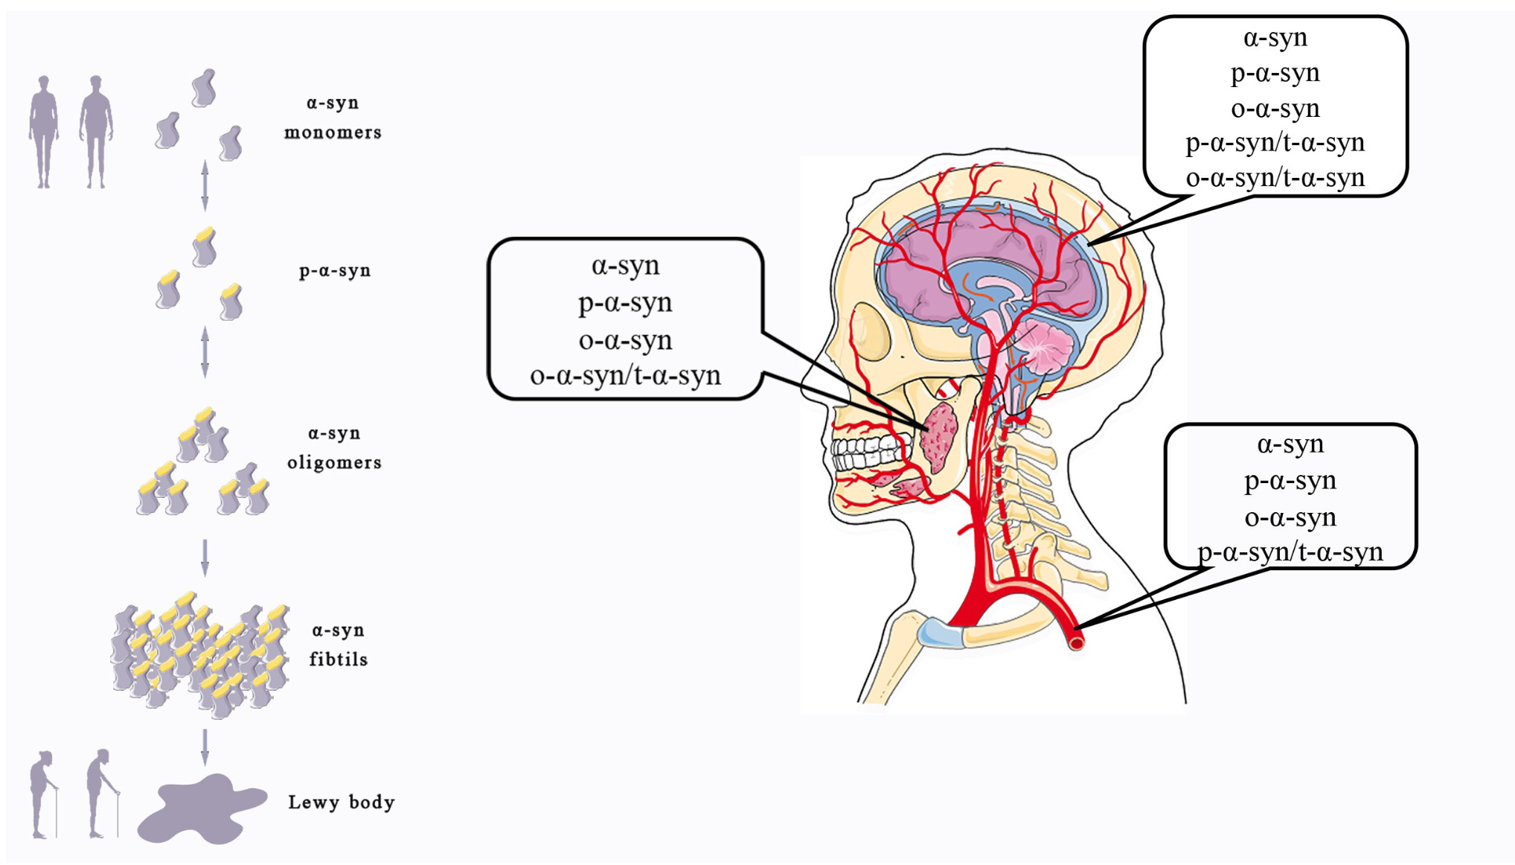
Figure 1.
Li et al., Conditioning Medicine 2022; 5(5): 172-185.

