Slide 1
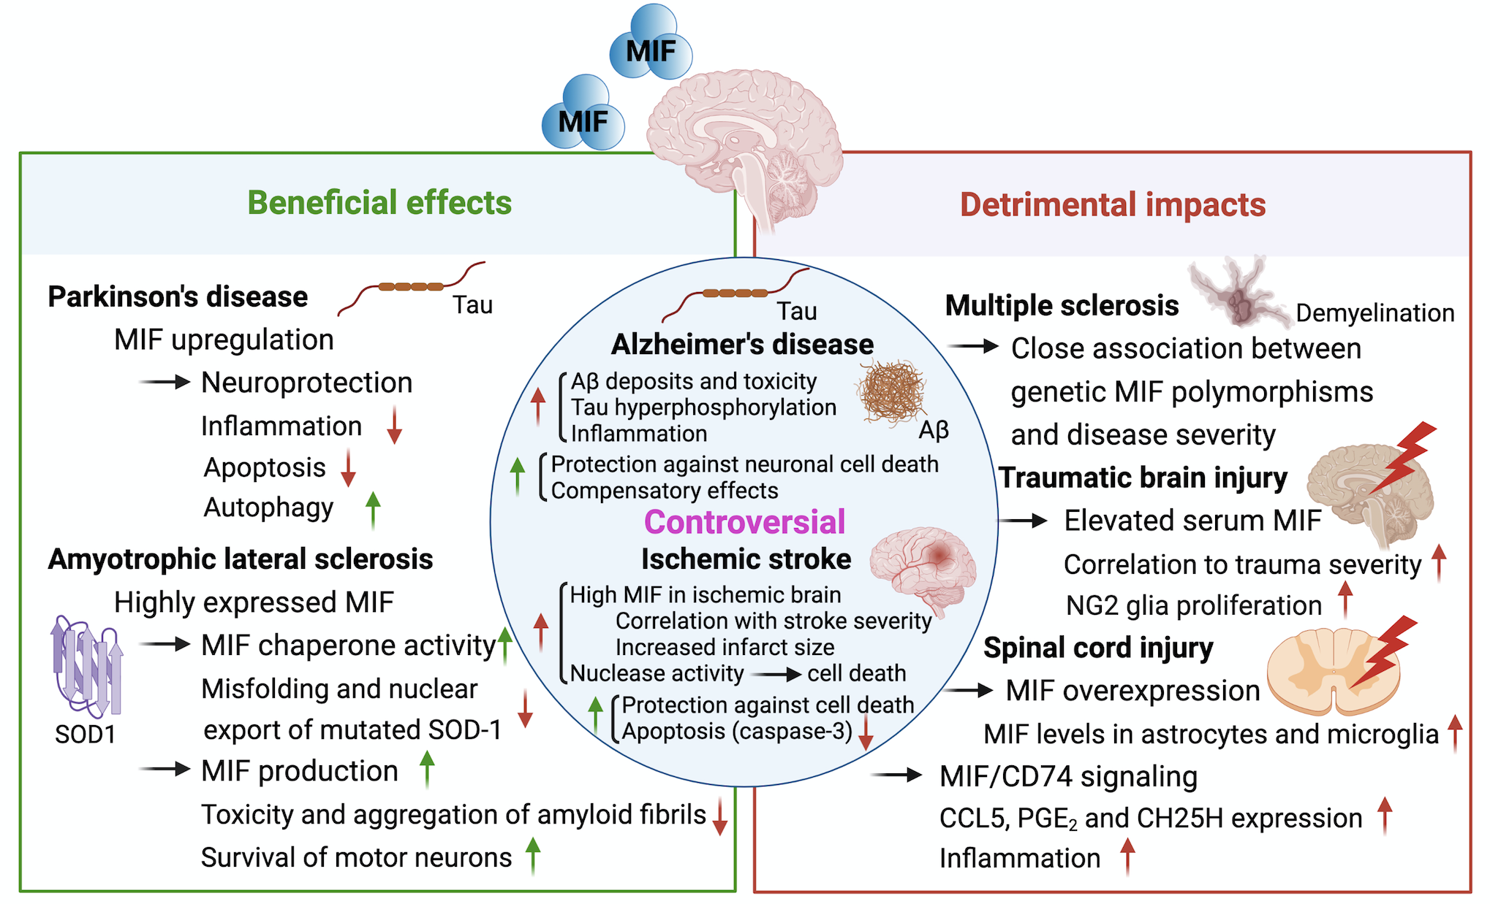
Figure 2. The multifaceted impact of MIF on several neurological diseases.
Zan et al, Conditioning Medicine 2021; 4(5):216-233

