Slide 1
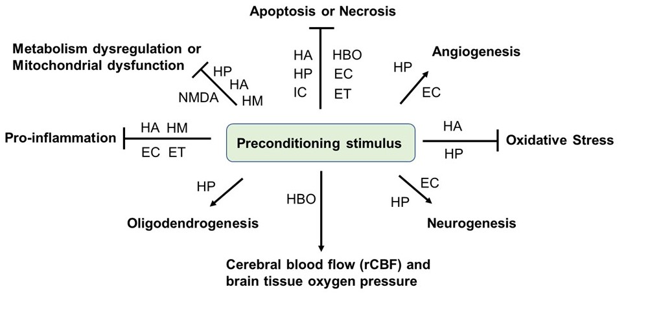
Figure 1.
Niamnud et al., Conditioning Medicine 2022; 5(6): 198-204.

