Slide 1
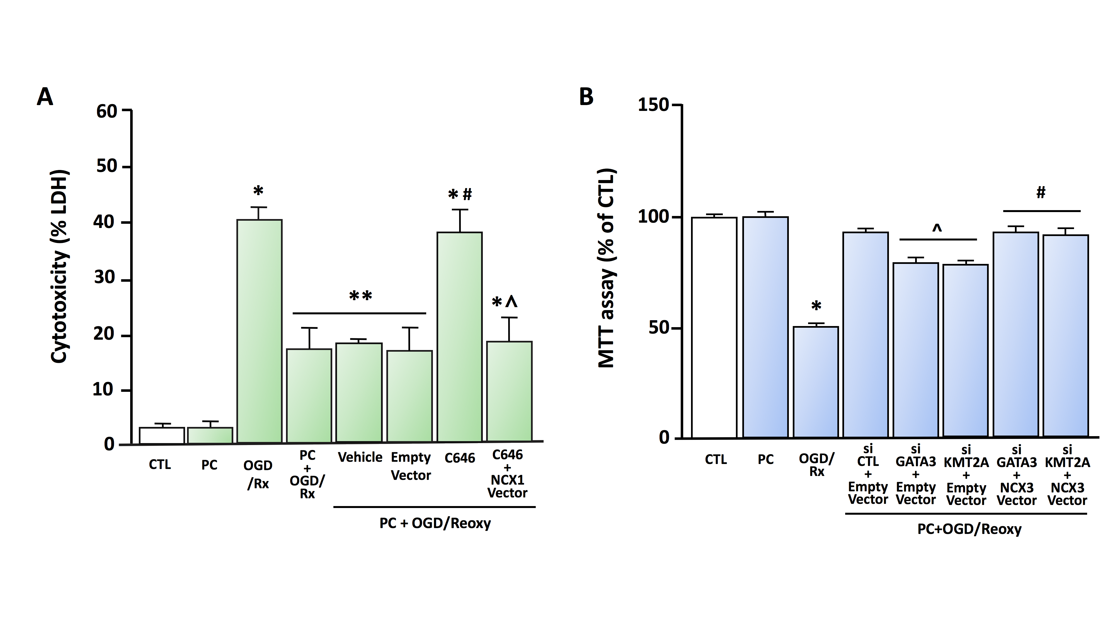
Figure 1.
Ruggiero et al.; Conditioning Medicine 2024; 7(1): 11-14.

