Slide 1
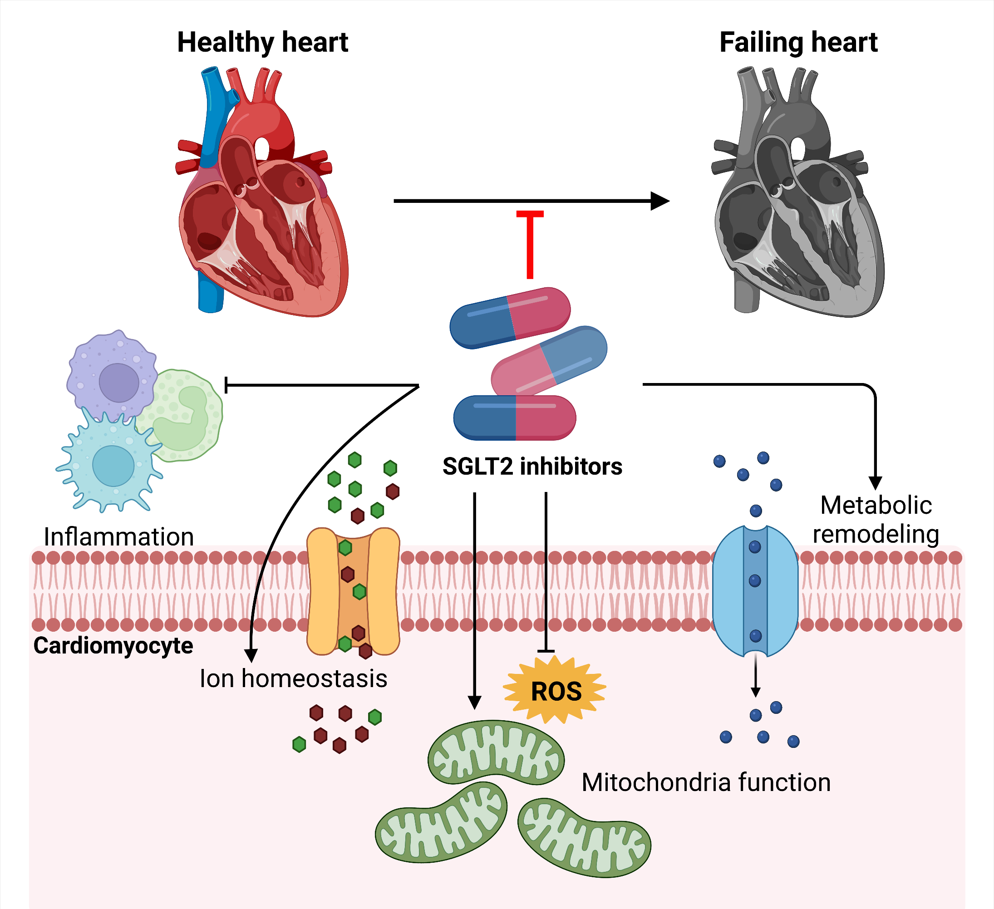
Figure 1. Summary of potential mechanistic actions of SGLT2 inhibitors.
Cong et al, Conditioning Medicine 2022; 5(1):1-10.

