Slide 1
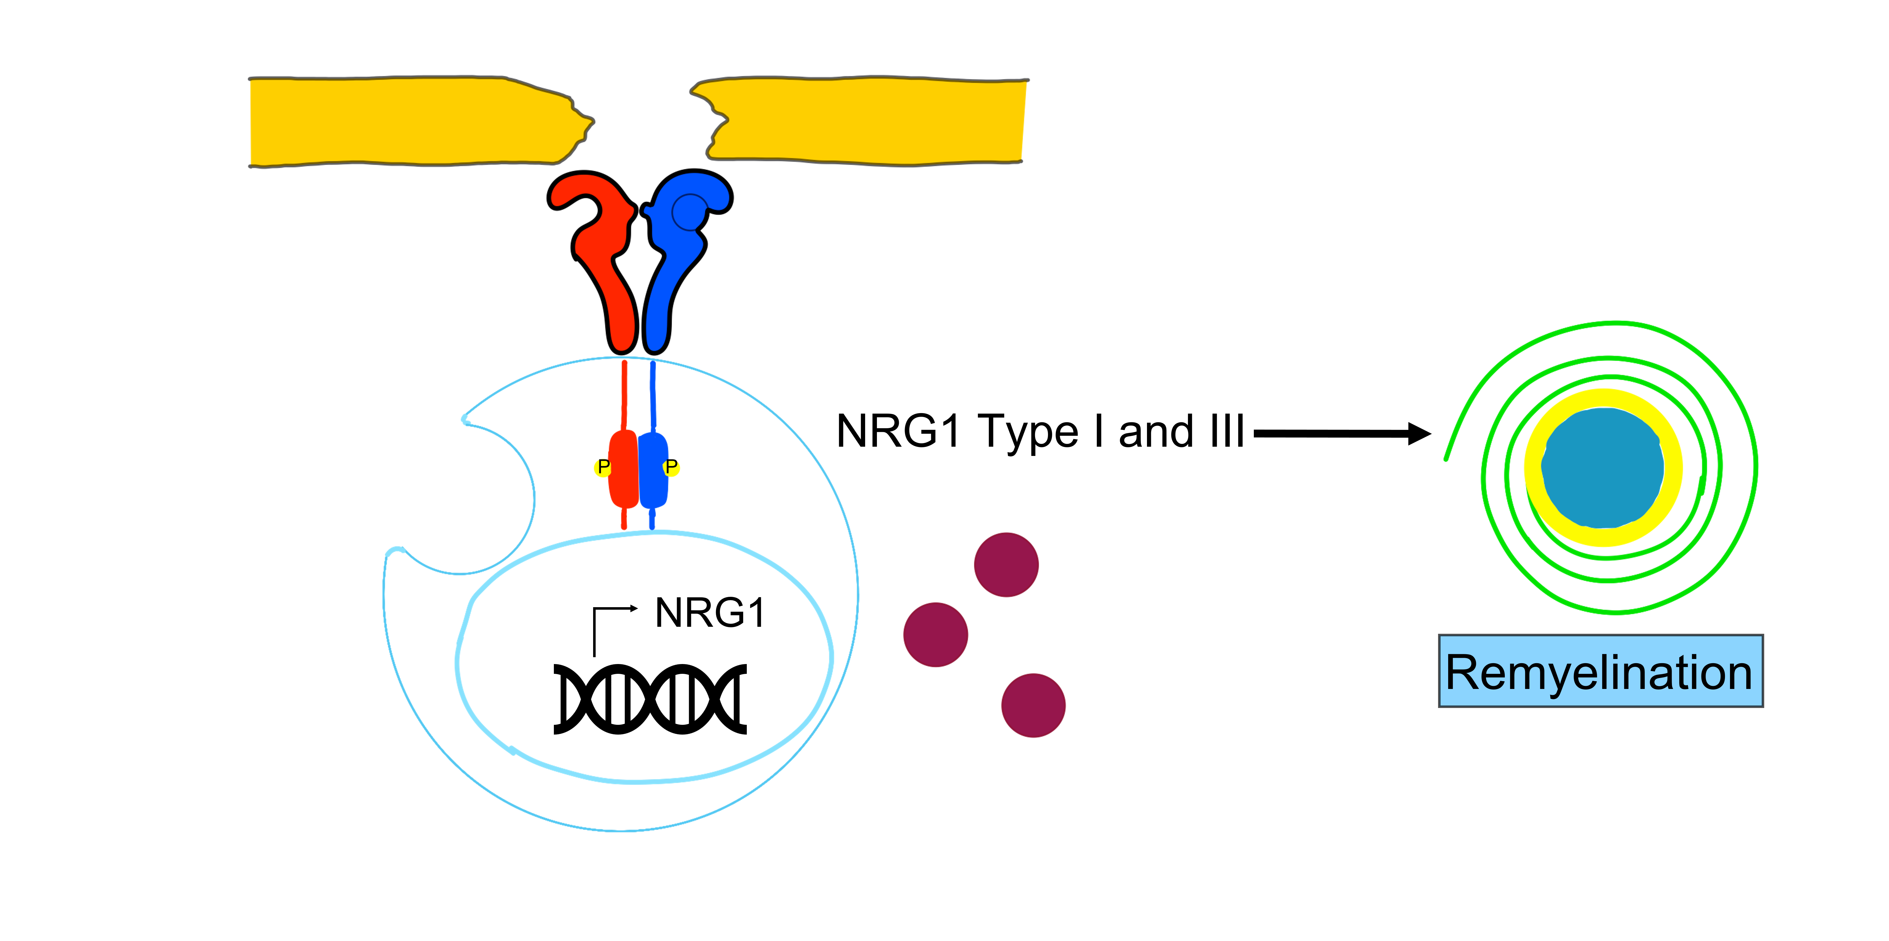
Figure 1.
Laudati et al.; Conditioning Medicine 2024; 7(1): 15-21.

