Slide 1
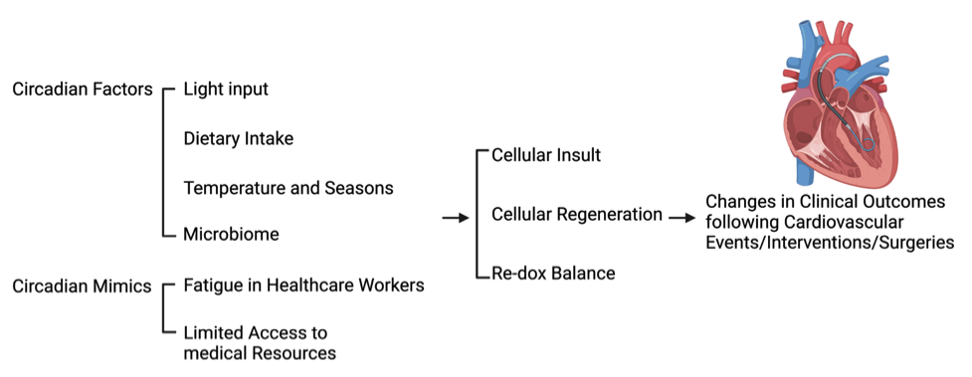
Figure 1. Potential circadian factors and mimics that affect cardiovascular clinical outcomes.
Ko et al, Conditioning Medicine 2021; 4(6):262-270.

