Slide 1
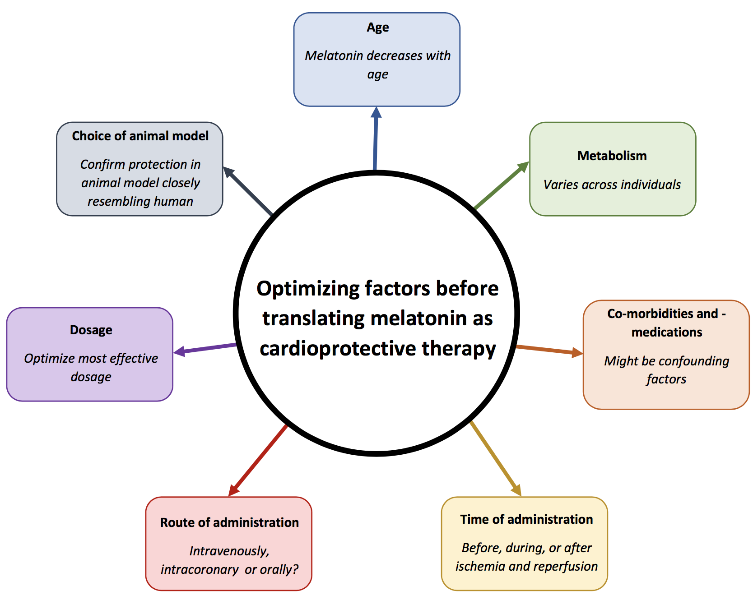
Figure 1. Key factors that may affect the cardioprotective effect of melatonin.
Lourens et al, Conditioning Medicine 2021; 4(6):271-279.

