Slide 1
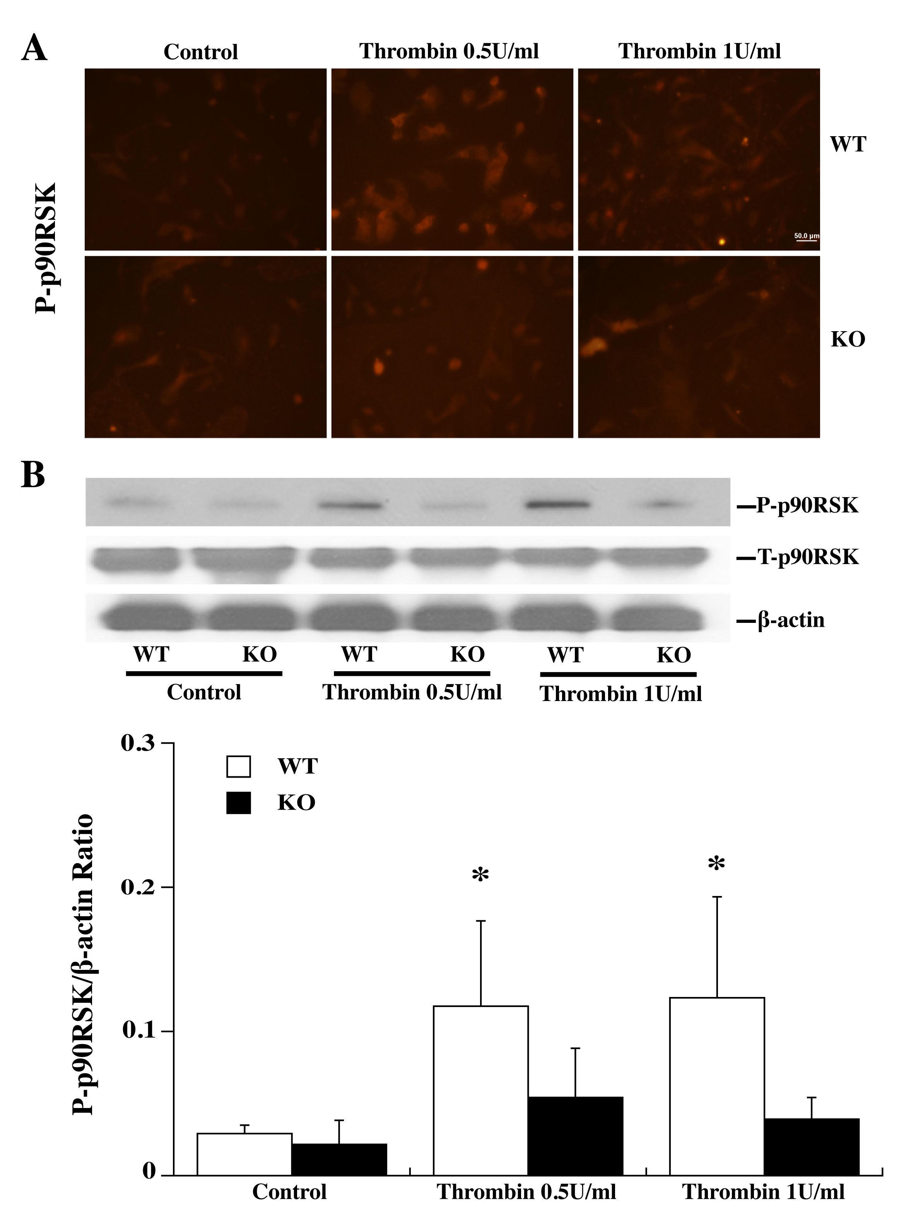
Figure 3: Primary astrocyte cultures from WT and PAR-1 KO mice were pretreated with 0 (control), 0.5 or 1.0 U/ml thrombin for 24 h and then collected for immunofluorescence staining and Western blot analysis.
Bao et al., Conditioning Medicine 2018; 1(2):57-63

