Slide 1
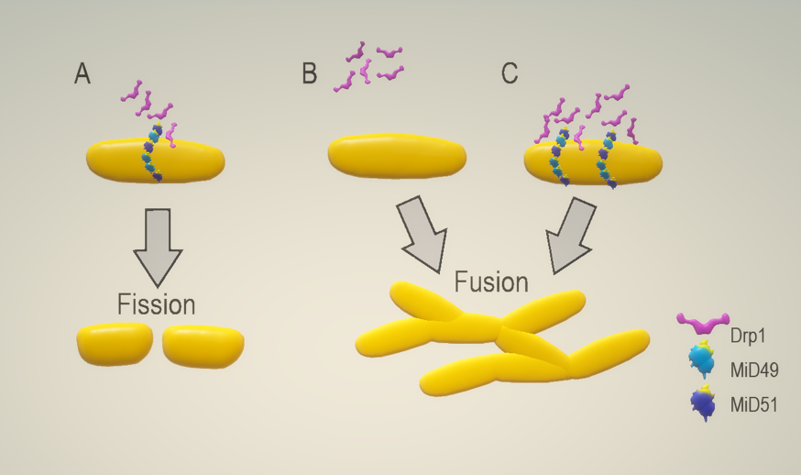
Figure 2: MiD depletion or overexpression promotes mitochondrial elongation.
Parisa Samangouei et al., Conditioning Medicine 2018; 1(5):239-246

