Slide 1
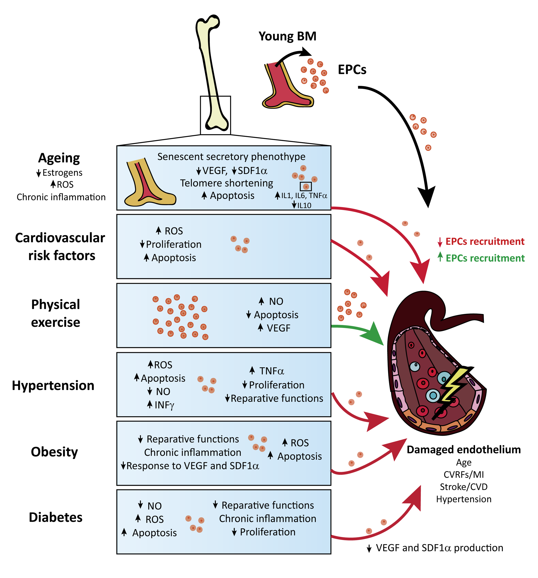
Figure 1. Schematic representation of the reported effects of comorbid conditions on EPC function and endothelial health in the context of cardiovascular disease.
Pradillo et al., Conditioning Medicine 2019; 2(1):18-29.

